Slide 1
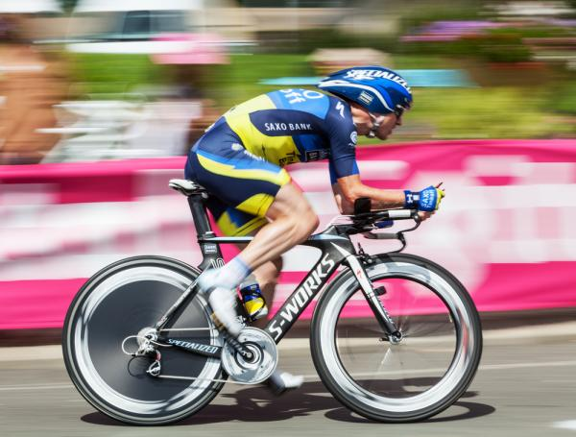
The Physiology of Training: Effect on VO₂ max, Performance, Homeostasis, and Strength

Slide 2
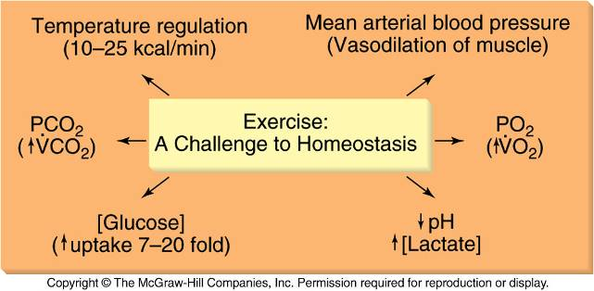
Exercise: A Challenge to Homeostasis

Slide 3
Principles of Training
1. Overload
Training effect occurs when a system
is exercised at a level beyond which it
is normally accustomed
2. Specificity
Training effect is specific to:
Muscle fibers involved
Energy system involved (aerobic vs. anaerobic)
Velocity of contraction
Type of contraction (eccentric, concentric, isometric)
3. Reversibility
Gains are lost when overload is removed

Slide 4
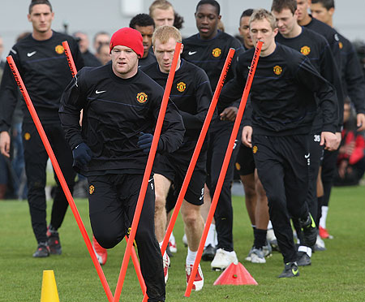
Endurance Training and VO_{2max}
Training to increase VO_{2max}
Large muscle groups, dynamic activity
20-60 min, 3-5 times/week, 50-85% VO_{2max}
Expected increases in VO_{2max}
Average = 15%
2-3% in those with high initial VO_{2max}
30–50% in those with low initial VO_{2max}
Genetic predisposition
Accounts for 40%-66% VO_{2max}
Prerequisite for high VO_{2max} (60–80 ml.kg⁻¹min⁻¹)

Slide 5
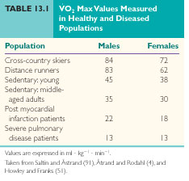
Range of VO_{2max} Values in the Population

Slide 6
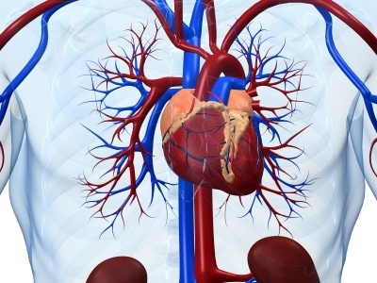
Calculation of VO_{2max}
Product of maximal cardiac output and arteriovenous difference (difference in O2 content between arterial blood & venous blood)
Differences in VO_{2max} in different populations
Due to differences in SV_{max}
Improvements in VO_{2max}
50% due to ↑SV
50% due to ↑a-vO₂
VO_{2max} = HR_{max} x SV_{max} x (a-vO₂)_{max}

Slide 7
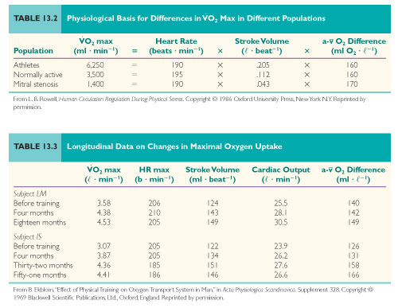

Slide 8
Increased VO_{2max} With Training
Increased Sv_{max}
↑ Preload (EDV):
End volumetric pressure that stretches the right or left ventricle of the heart to its greatest dimensions
…therefore preload = initial stretching of the cardiac muscles before contraction.
*Preload = Volume (If the volume is low, the blood pumped out of the heart will be a trickle. If the volume is too high, it will back up the cardiac system (right-sided heart failure, edema etc)
*Afterload = Pressure/Resistance (Afterload = pressure or resistance. If there is a narrowing in the veins/arteries, the volume will back up AND the cardiac output will drop.)

Slide 9
Increased VO_{2max} With Training
1. Increased Sv_{max} (cont…)
Preload is increased by increasing the end-diastolic volume (this occurs with increased venous pressure)
As ventricle contracts = develop greater pressure & eject blood more rapidly (because the Frank Starling Mechanism = activated by the increased preload.)

Slide 10
Because ↑ venous pressure:
(pressure exerted on the walls of the veins by the circulating blood)
↑ Plasma volume (yellowish solution ±91% water & other 9% = nutrients: glucose, amino acids; sodium, potassium; antibodies)
↑ Venous return (volume of blood flowing back to the heart through the veins.)
↑ Ventricular volume

Slide 11
Increased VO_{2max} With Training
2. ↓ Afterload (TPR):
Tension or stress developed in the wall of the left ventricle during ejection.
end load (pressure) against which the heart contracts to eject blood.
Afterload is broken into components: aortic pressure and/or the pressure the ventricle must overcome to eject blood.

Slide 12
Increased VO_{2max} With Training
2. ↓ Afterload (TPR):
↓ Arterial constriction
↑ Maximal muscle blood flow with no change in mean arterial pressure
3. ↑ Contractility

Slide 13
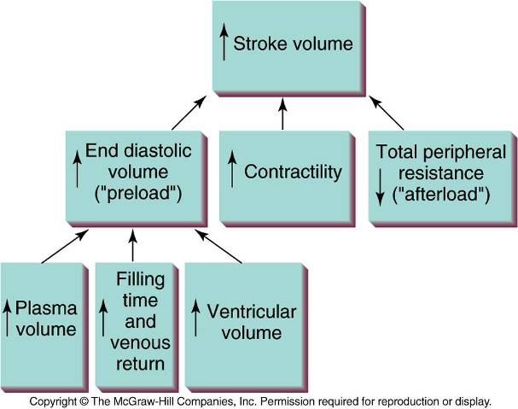
Factors Increasing Stroke Volume

Slide 14
Increased VO_{2max} With Training
4. a-vO_{2max}
↑ Muscle blood flow = ↑ O2 to active muscles
Therefore ↓ SNS vasoconstriction
[= vasodilation to ↑ blood flow to muscles]
→Improved ability of the muscle to extract oxygen from the blood
↑ Capillary density
↑ Mitochondial number (therefore ↑ ATP produced)

Slide 15
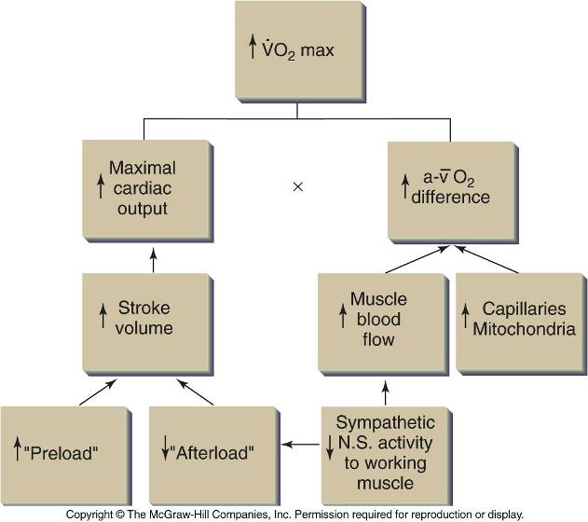
Factors Causing Increased VO_{2max}

Slide 16
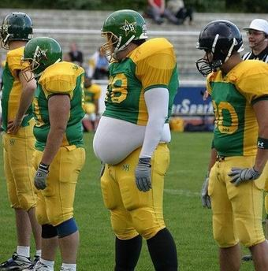
Detraining and VO_{2max}
Decrease in VO_{2max} with stopping
training
↓ SVmax
Rapid loss of plasma volume
↓ Maximal a-vO₂ difference
↓ Mitochondria
↓ Oxidative capacity of muscle (ability to produce ATP)
↓ Type IIa fibers [red → myoglobin]
[long term anaerobic → slow fatigue]
↑ type IIx fibers [white → no myoglobin]
[short term aerobic → quicker to fatigue]

Slide 17
Effects of Endurance Training on Performance
Maintenance of homeostasis:
More rapid transition from rest to steady-state
Reduced reliance on glycogen stores
Cardiovascular and thermoregulatory adaptations
Neural and hormonal adaptations:
Initial changes in performance
Improved neural drive, improved recruitment patterns
Improved hormone synthesis, ↑ hormone receptors in tissue
Structural and biochemical changes in muscle:
↑ Mitochondrial number
↑ Capillary density

Slide 18
Structural and Biochemical Adaptations to Endurance Training
↑ capillary density
↑ number of mitochondria
↑ in oxidative enzymes
(↑ catalysts in reactions that produce ATP):
Krebs cycle (citrate synthase)
Fatty acid cycle
Electron transport chain

Slide 19
Structural and Biochemical Adaptations to Endurance Training
Increased NADH shuttling system (glycolysis)
NADH from cytoplasm to mitochondria
Change in type of LDH (lactate dehydrogenase):
LDH catalyses oxidation of lactate to pyruvate & predominates in slow-twitch muscle fibres.
Endurance training → activity of LDH increases in slow-twitch fibres = improved the ability of muscles to oxidize lactate.

Slide 20
Time Course of Training/Detraining Mitochondrial Changes
Training
Mitochondria double with 5 weeks of training
Detraining
±50% of the increase in mitochondrial content lost after 1 week of detraining
All of the adaptations lost after 5weeks of detraining
4 weeks of retraining to regain the adaptations lost in the first week of detraining

Slide 21
Effect of Intensity and Duration on Mitochondrial Adaptations
Citrate Synthase (CS)
Marker of mitochondrial oxidative capacity
Found in Citric acid (Krebs cycle) – aerobic metabolism
Light to moderate exercise training
Increased CS in high oxidative fibers
Type I (slow) and IIa (intermediate fast/ fast twitch oxidative )
Strenuous exercise training
Increased CS in low oxidative fibers
Type IIx (fast glycolytic)

Slide 22
*Biochemical Adaptations and the Oxygen Deficit
ADP stimulates mitochondrial ATP production
Increased mitochondrial number after training
Lower ADP needed to increase ATP production and VO₂

Slide 23
*Biochemical Adaptations and the Oxygen Deficit
Oxygen deficit is lower after training:
Same VO₂ but lower ADP needed
Energy requirement can be met by oxidative ATP production at the onset of exercise
→Faster rise in VO₂ curve & steady-state reached earlier
= less lactic acid formed & less PC depletion
Therefore: rapid ↑ in O₂ uptake at the onset of exercise from ↑ aerobic enzymes in the mitochondria which have ↑ in number.

Slide 24
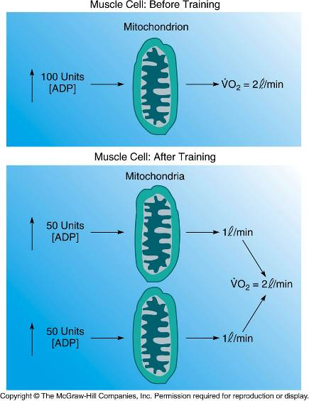
*Mitochondrial Number and ADP Concentration Needed to Increase VO₂

Slide 25
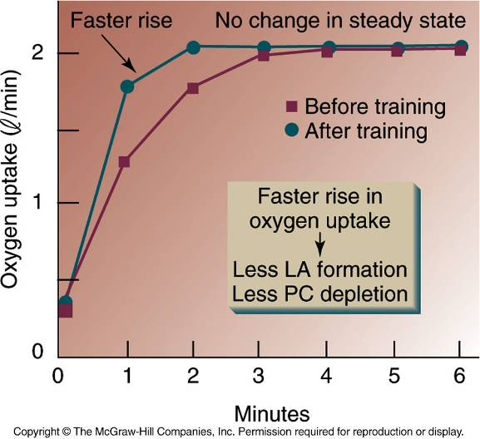
*Endurance Training Reduces the O₂ Deficit

Slide 26
*Biochemical Adaptations and the Plasma Glucose Concentration
Increased utilization of fat = sparing of plasma glucose & muscle glycogen
Transport of FFA into the muscle:
Increased blood capillary density
= Slower blood flow and greater FFA uptake

Slide 27
*Biochemical Adaptations and the Plasma Glucose Concentration
Transport of FFA from the cytoplasm to the mitochondria
Increased mitochondrial number
Mitochondrial oxidation of FFA
Increased enzymes of β-oxidation
Increased rate of acetyl-CoA formation
High citrate level inhibits PFK and glycolysis
Therefore: the ↑ uptake of FFA from the blood circulation is from ↑ capillary density and ↑ enzymes for metabolism of FFA.

Slide 28
*Biochemical Adaptations and Blood pH
Lactate production during exercise
Increased mitochondrial number
Less carbohydrates used = less pyruvate formed
Increased NADH shuttles
= Less NADH available for lactic acid formation
Therefore: Increased capillary density helps increase O₂ availability = reduces anaerobic metabolism.
LDH
pyruvate + NADH
lactate + NAD

Slide 29
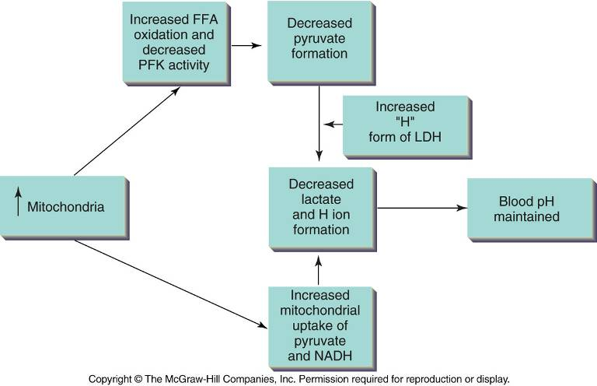
Mitochondrial and Biochemical Adaptations and Blood pH

Slide 30
*Biochemical Adaptations and Lactate Removal
Lactate removal
By nonworking muscle, liver, and kidneys
Gluconeogenesis in liver
Increased capillary density
Muscle can extract same O2 with lower blood flow
More blood flow to liver and kidney
Increased lactate removal

Slide 31
*Biochemical Adaptations and Lactate Removal
Increased enzymes in the increased number of mitochondria
= help with the metabolism of lactate
= lactate removal by increased capillaries to organs e.g. heart → which can metabolise lactate more

Slide 32
Links Between Muscle and Systemic Physiology
Biochemical adaptations to training influence the physiological response to exercise
Sympathetic nervous system (↓ E/NE)
Cardiorespiratory system (↓ HR, ↓ ventilation)
Due to:
Reduction in “feedback” from muscle chemoreceptors
Reduced number of motor units recruited
Shown in one leg training studies
→ Lack of transfer of training effect to untrained leg

Slide 33
Peripheral and Central Control of Cardiorespiratory Responses
Peripheral feedback from working muscles:
= Group III and group IV nerve fibers
Responsive to tension, temperature, and chemical changes
Feed into cardiovascular control center
Central Command:
Motor cortex, cerebellum, basal ganglia
Recruitment of muscle fibers
Stimulates cardiorespiratory control center

Slide 34
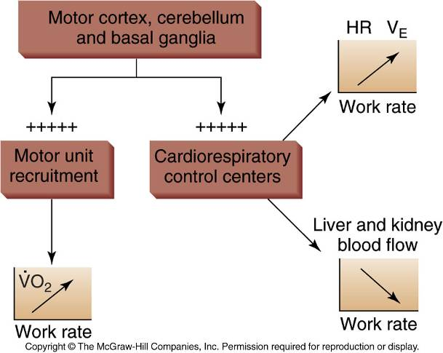
Central Control of Cardiorespiratory Responses

Slide 35
Physiological Effects of Strength Training
Strength training results in increased muscle size and strength
Neural factors:
Increased ability to activate motor units
Strength gains in first 8-20 weeks
Muscular enlargement
Mainly due enlargement of fibers
Hypertrophy
May be due to increased number of fibers
Hyperplasia

Slide 36
Adaptations from strength training
Glycolytic enzymes: Enhanced muscular storage of glycogen and increases in the levels of glycolytic enzymes – especially with high volume resistance training
Intramuscular fuel stores eg. Glycogen
Ligament and tendon strength Increase in collagen content (only with high loads) to increase cross sectional area of tendon/ ligament
Increased bone mineral content. Increase mechanical stress on bone = increase bone formation/ density

Slide 37
Limitations to strength adaptations
Hormones (testosterone, HGH)
Nutrition (Protein, Carbs)
Muscle size (smaller muscles have fewer muscle fibers)
Type and intensity of training
Specificity
Lack of rest
Genetics

Slide 38
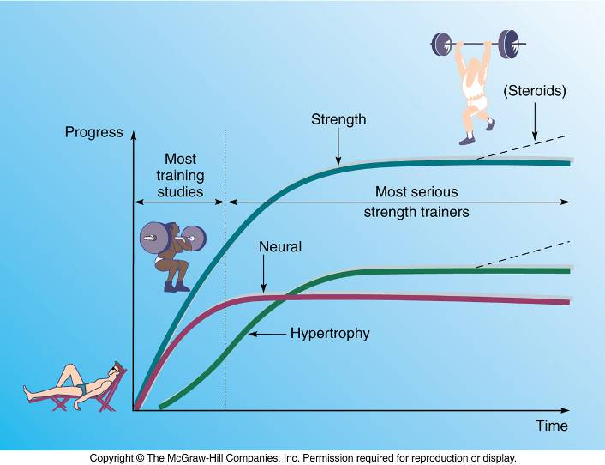
Neural and Muscular Adaptations to Resistance Training

Slide 39
Training to Improve Muscular Strength
Traditional training programs
Variations in intensity, sets, and repetitions
Periodization
Volume and intensity of training varied over time
More effective than non-periodized training for improving strength and endurance
Strength and endurance training at same time
Adaptations may or may not interfere with each other
Depends on intensity, volume, and frequency of training

Slide 40
Revision Questions
1. Name the 3 principles of training and describe what each entails. (9)
2. How is VO2max improved with training? (4)
3. Discuss each training adaptation for VO2max. (15)
4. How will detraining affect VO2max? (4)
5. What are the structural and biochemical adaptations to endurance training? (5)
6. What are the effects of intensity and duration on mitochondrial adaptations? (5)
7. Why is oxygen deficit lower after training? (4)
8. How is the plasma glucose concentration affected by training? (6)
9. How is the blood pH affected by training? (5)

Slide 41
Revision Questions
10. What are the physiological effects of strength training? (8)
11. What are the adaptations to strength training? (8)
12. What are the limitations to strength training? (8)
13. What are the capillary and mitochondrial changes that occur with endurance training with regards to: Oxygen deficit Utilization of FFA Glucose Sparing Lactate and Hydrogen formation Blood pH Lactate Removal (6 x 3)

